Slide 1



Global Warming Potential Expanded: The Cumulative Global Warming Potential of HFC – 134a
Dr. Paul Blowers
Christina Canter
Daniel Galvan
NASA Space Grant Symposium Tucson, AZ
April 21, 2012

Slide 2
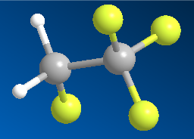
Background History of Hydrofluorocarbon (HFC) 134a
Implemented as a replacement for the ozone depleting chlorofluorocarbons (blowing agents, solvents, refrigerants, everywhere!!!)
Better physical and structural properties
Research suggests that over the past 10 years the concentration of 1,1,1,2-tetrafluoroethane has increased significantly in the Earth's atmosphere, with a recent study revealing a doubling in atmospheric concentration between 2001 and 2004 - Source: http://en.wikipedia.org/wiki/1,1,1,2-Tetrafluoroethane

Slide 3
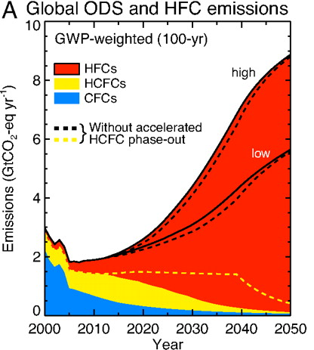
Emissions of HFC-134a are Increasing
How will this effect the environment??
Source:Velders, Guus J. M., David W. Fahey, John S. Daniel, Mack McFarland, and
Stephen O. Andersen. 2009. The large contribution of projected HFC emissions to
future climate forcing. Proceedings of the National Academy of Sciences of the United
States of America 106, no. 27: 10949-10954.

Slide 4
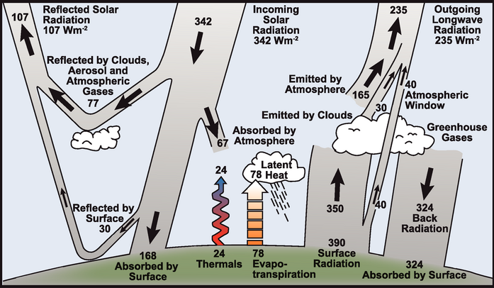
Atmospheric Energy Balance And the Greenhouse Effect
Source: Intergovernmental Panel for Climate Control (IPCC)

Slide 5
The Global Warming Potential: Quantifying the Greenhouse Effect
Dependent on two parameters
Traditionally only calculated for the parent species

Slide 6
The Cumulative GWP
The current research encompasses not only the parent species, but all of the byproduct species
Traditionally: CF₃CH₂F
New approach: CF₃CH₂F, CF₃CHFO_{2,} CF₃CHFO, CF₃CHFO₂NO_{2,} CF₃CHFOOH, CF₃COF, HCOF, CF₃, CF₃COOH, CF₃COO-, HCOOH, FCO, CF₃O₂, CF₃O, CF₃OH, CF₂O and FNO

Slide 7
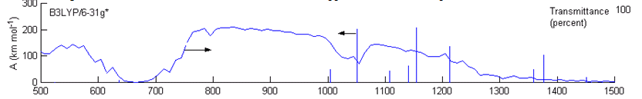
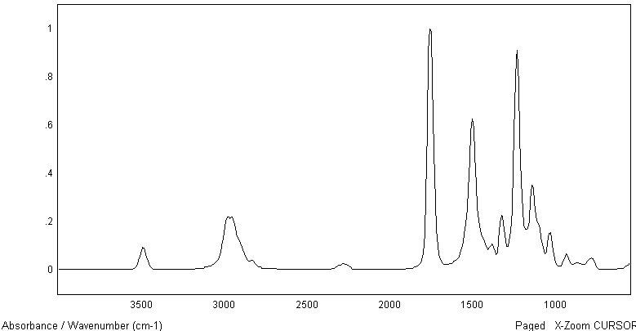
Radiative Forcing
Caused by absorption of UV energy
Calculated using computational chemistry
Computational
Experimental

Slide 8
Atmospheric Degradation Model
Numerous reactions, too complex to do by hand
Turn to mathematical software
The [x(t)] term in the GWP definition

Slide 9
RESULTS: Turns out that degradation byproducts do have an effect
Several stable species were identified
CF₃COF
CF₃COOH
COF₂
Cases of microbial digestion and conversion into
Methane (CH₄)
Fluoroform (CF₃H)
Dependent on atmospheric water content
Gives rise to the idea of a ‘local’ GWP

Slide 10
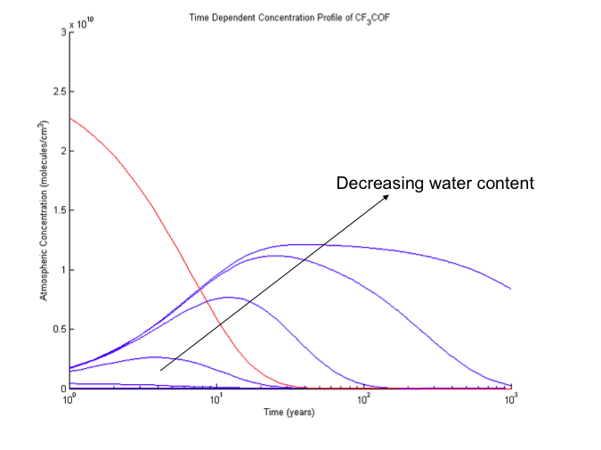
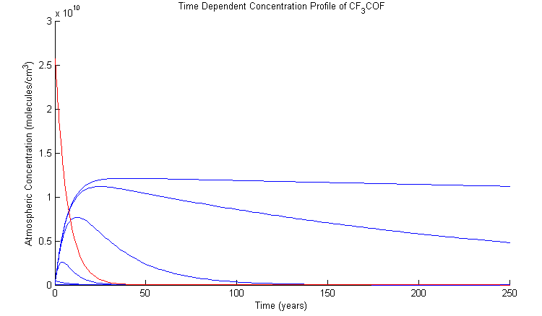
RESULTS: Time-Dependent Concentration Profile of HFC-134a and byproducts
Decreasing water content

Slide 11
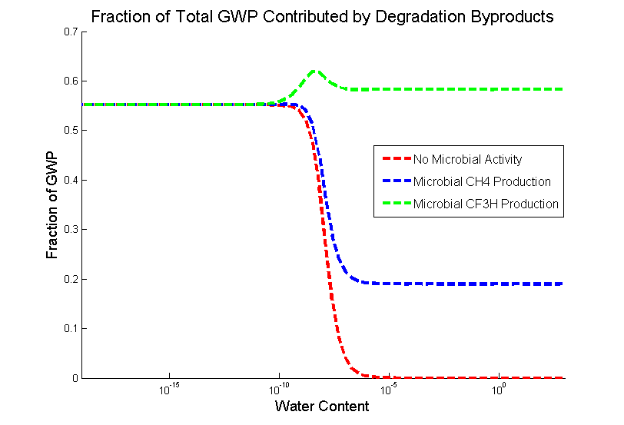
RESULTS: Assessing the Different Types of Microbial Activity
“Microbial sinks exist in nature for the elimination of TFA from the environment… oxic degradation of TFA leads to the formation of fluoroform.”
-Nature¹
¹ VISSCHER, PT, CW CULBERTSON, and RS OREMLAND. 1994. Degradation of trifluoroacetate in oxic and anoxic sediments. Nature 369, no. 6483: 729-731.

Slide 12
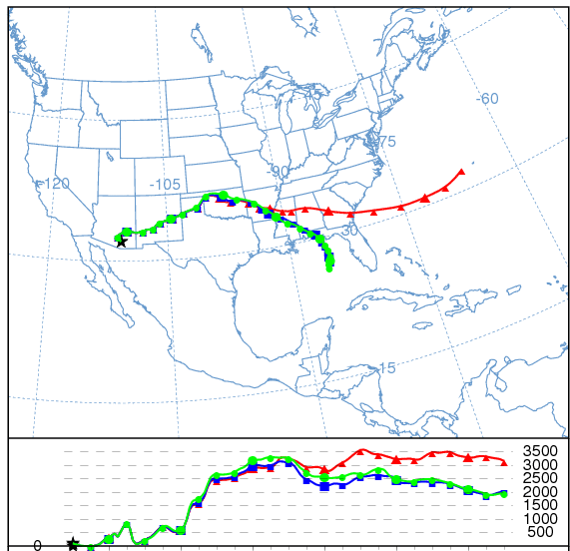
Local GWP is highly dependent on weather patterns as well as ecology
Initial Emission Height:
1000 m
500 m
20 m
Source: National Oceanic and Atmospheric Administration (NOAA)

Slide 13
Environmental Foresight
Hindsight has perfect vision
Chlorofluorocarbons (CFCs)
Methyl tert-Butyl ether (MTBE)
Dichloro-Diphenyl-Trichloroethane (DDT)
Future work to assess the newest refrigerant, HFO-1234yf
In conclusion….

Slide 14
Thank you!
Dr. Paul Blowers
Christina Canter
The Whole Space Grant Team
Susan Brew and Barron Orr
Alexandria Staton

Slide 15


Slide 17
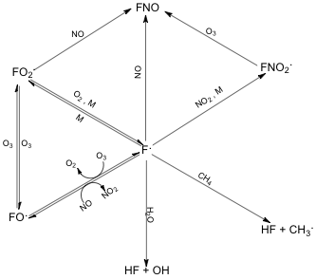
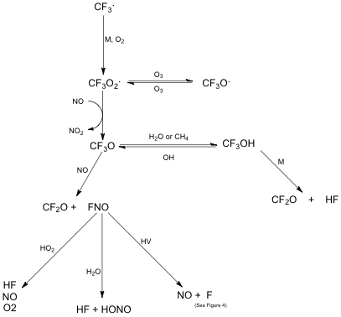
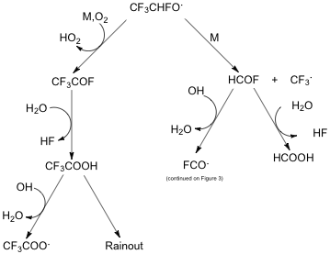
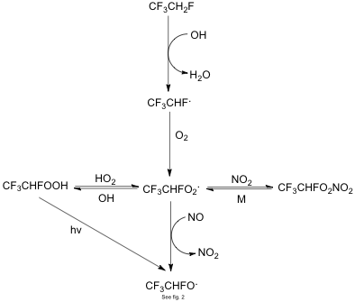

Slide 18
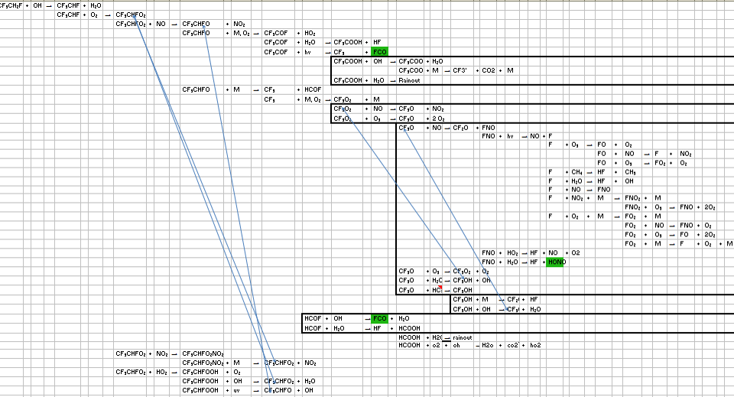

Slide 19
Sample input for getting Radiative Forcing #b3lyp/ 6-311g** opt nosym CF3CH2F 0 1 F1 C2 F1 Rc2f1 C3 C2 Rc3c2 F1 Ac3c2f1 F4 C3 Rf4c3 C2 Af4c3c2 F1 Df4c3c2f1 F5 C2 Rf5c2 C3 Af5c2c3 F1 Df5c2f1 F6 C2 Rf6c2 C3 Af6c2c3 F1 Df6c2f1 H7 C3 Rh7c3 C2 AH7c3c2 F4 Dh7c3f4 H8 C3 Rh8c3 C2 Ah8C3c2 F4 Dh8c3f4 Rc2f1=1.351053 Rc3c2=1.51816884 Rf4c3=1.37868584 Rf5c2=1.34292671 Rf6c2=1.34280356 Rh7c3=1.09187412 Rh8c3=1.0916946 Ac3c2f1=108.8732555 Af4c3c2=109.65518505 Af5c2c3=111.96556334 Af6c2c3=111.96043895 AH7c3c2=108.74900446 Ah8C3c2=108.72943303 Df4c3c2f1=179.82288173 Df5c2f1=119.34529524 Df6c2f1=-119.3739547 Dh7c3f4=119.73167037 Dh8c3f4=-119.72990143

